Slide 1
Vibration Frequency Estimation via
AI-Based Motion Magnification
25-1 DLIP Final Project Proposal
School of Mechanical and Control Engineering Prof. YoungKeun-Kim
22000355 HyeonGyu-Seo 22200757 Joungbin Choi
한동대학교

Slide 2


Introduction
Machine Defects
Condition monitoring of existing industrial facilities is performed based on physical sensors.
This project aims to implement non-contact sensing technology
Using Motion Magnification to amplify micro-vibrations in images
Problem Statement
Situations where physical sensor attachment is difficult - high temperature/high pressure environment, narrow space, moving objects, etc.
Sensor environment vulnerable to noise - magnetic field interference, structural vibration confusion
When single component vibration localization is required - status analysis of specific parts, not the entire facility

Slide 3
Goal of Project & Target Customers
The Main Goal
To solve the problems mentioned in the problem statement, we want to analyze vibrations using cameras and deep learning models. This will allow us to predict the possibility of failure and prevent plant losses.
Target Performance
Model
PSNR > 25.0 dB
SSIM > 0.9
Visualization & Detect Vibration
XT-Slice Visualization
Image Processing
Target Customers
Smart Factory Integrators – for condition monitoring of machines in automated manufacturing environments
Plant Maintenance Service Providers – where large-scale equipment needs frequent non-invasive inspection
Robot Health Diagnostics Companies – enabling remote or visual-based state estimation for robots or mechatronic systems

Slide 4
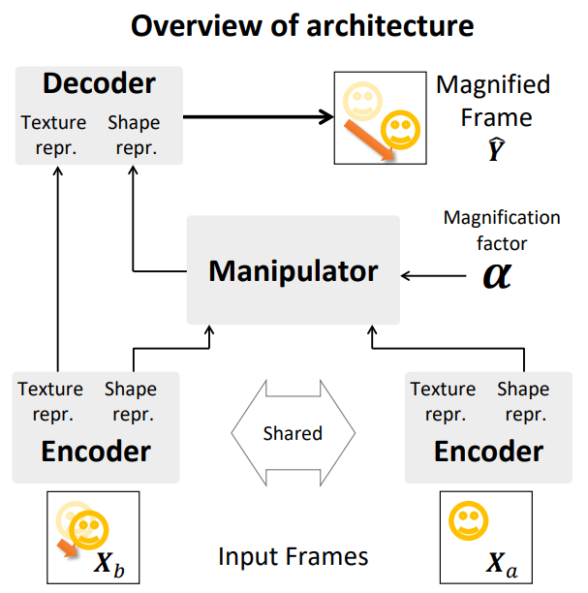
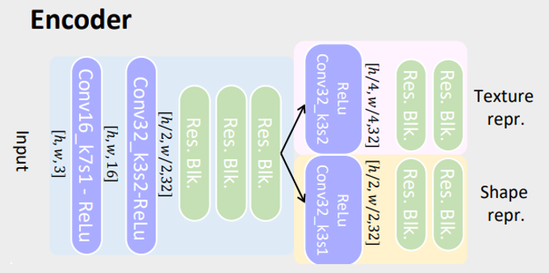
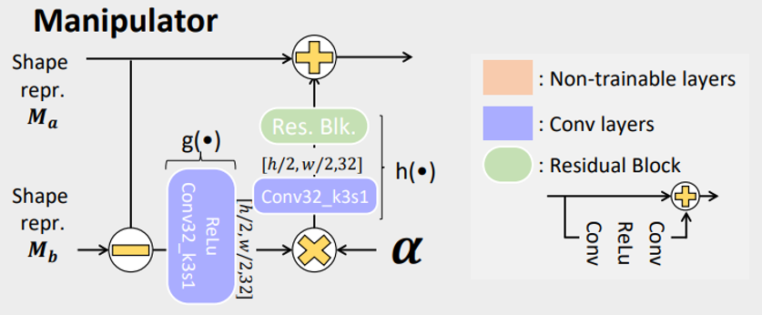
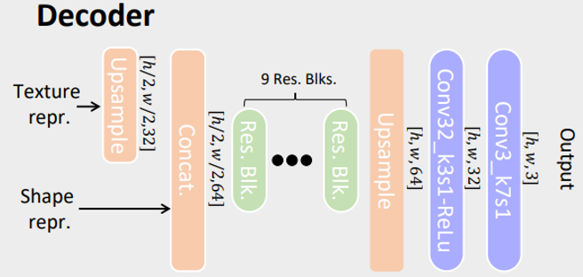
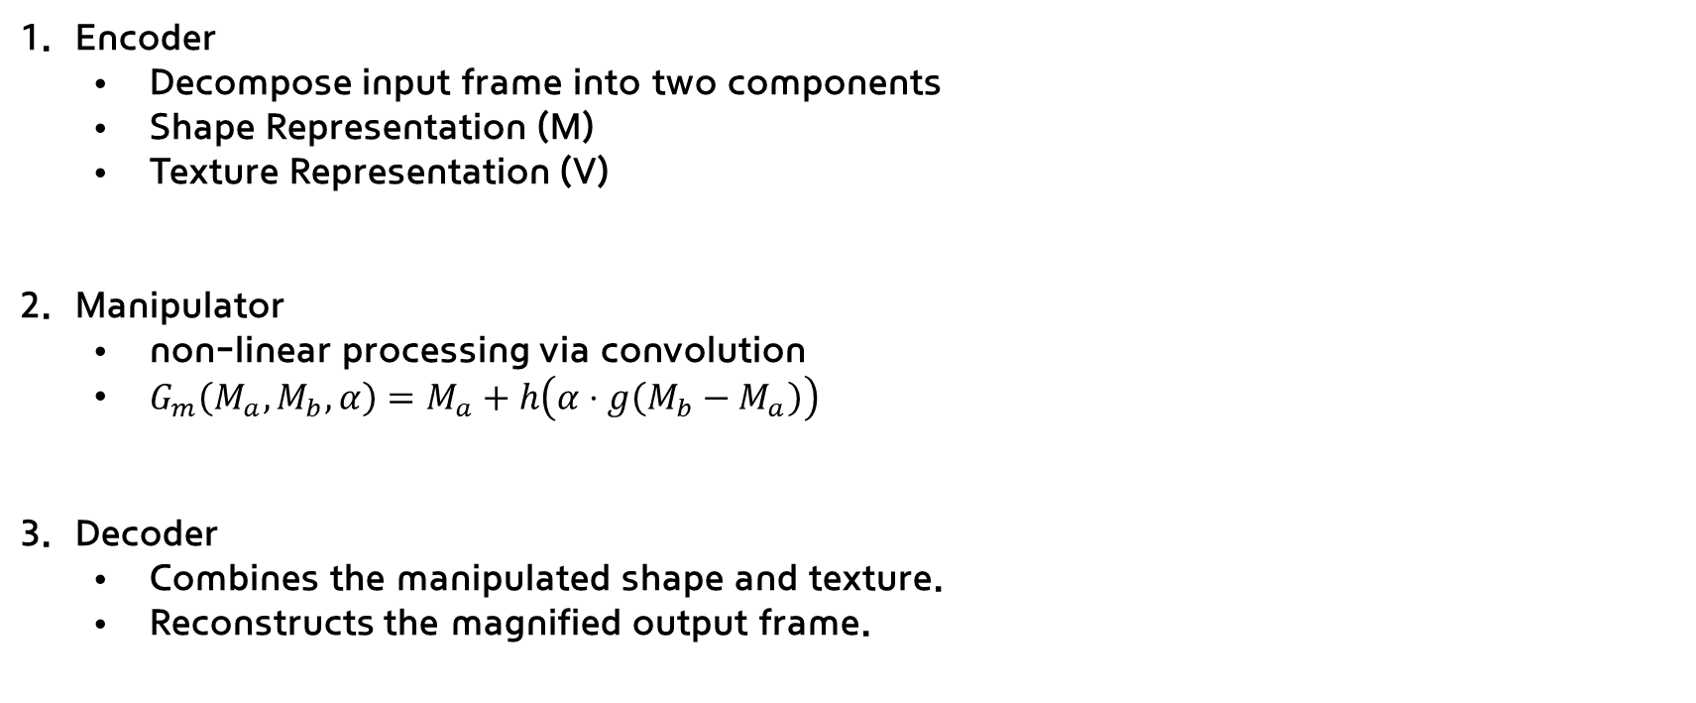
Magnification Model Architecture
Encoder
Decompose input frame into two components
Shape Representation (M)
Texture Representation (V)
Manipulator
non-linear processing via convolution
$G_{m}\left(M_{a}, M_{b}, α\right)=M_{a}+h\left(α⋅g\left(M_{b}−M_{a}\right)\right)$
Decoder
Combines the manipulated shape and texture.
Reconstructs the magnified output frame.

Slide 5
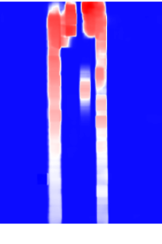
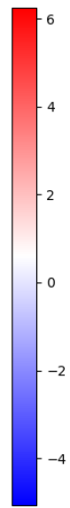
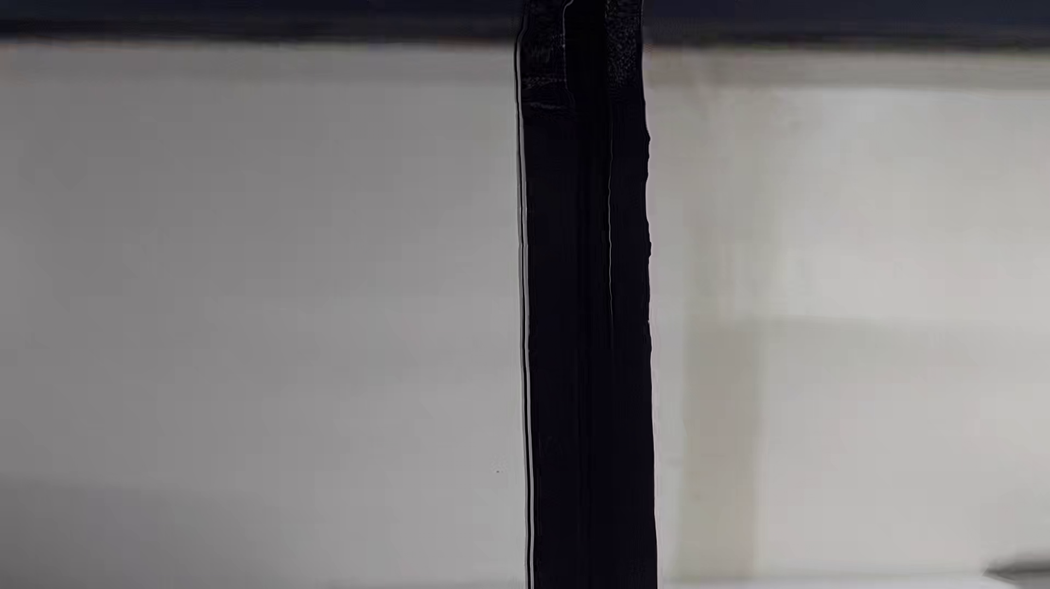
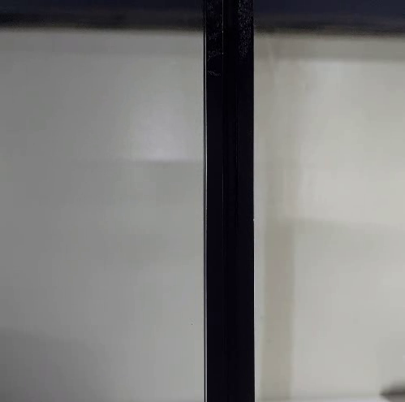
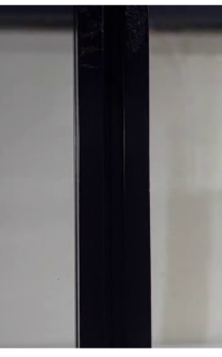

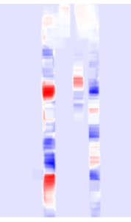
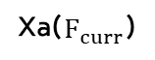
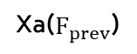
Create Train Dataset
Extract frames from video
Construct input pairs (Xa, Xb)
Estimate pixel movement between two consecutive frames
Generate target (Y) using Optical Flow warping
여기다 실험 세팅 한거 사진 하나?
Input video.mp4
Xa($F_{prev}$)
Xa($F_{curr}$)
dx(Horizontal)
dy(Vertical)
Warped Y (x 10.0)

Slide 6
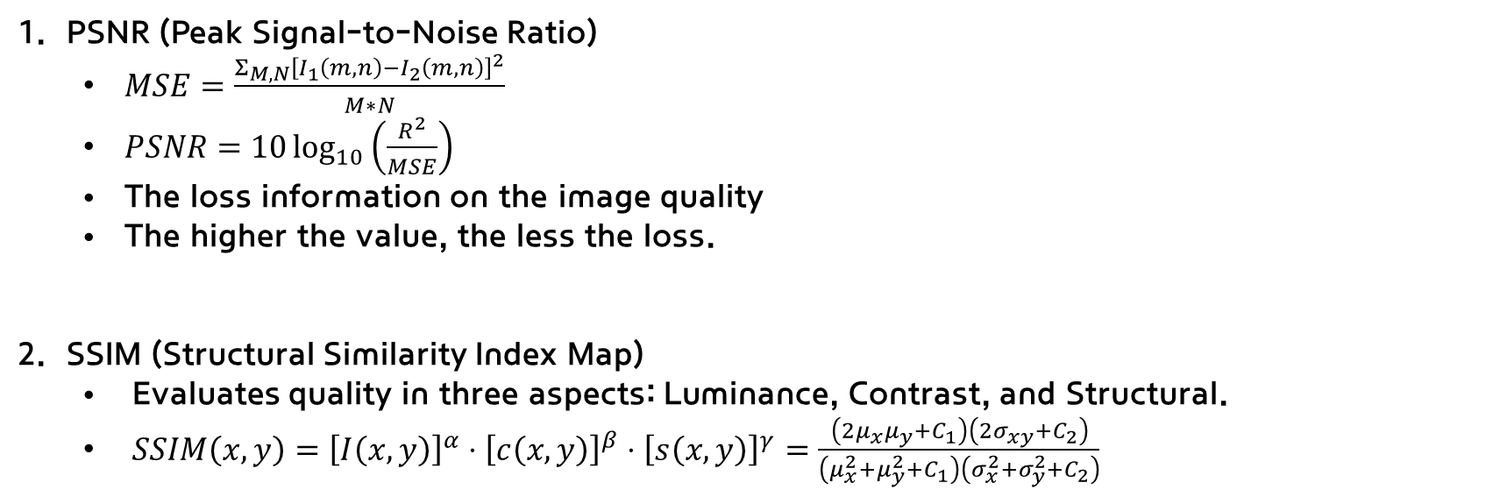
Evaluation
PSNR (Peak Signal-to-Noise Ratio)
$MSE=\frac{Σ_{M,N}{\left[I_{1}\left(m,n\right)−I_{2}\left(m,n\right)\right]}^{2}}{M∗N}$
$PSNR=10\log_{10}\left(\frac{R^{2}}{MSE}\right)$
The loss information on the image quality
The higher the value, the less the loss.
SSIM (Structural Similarity Index Map)
Evaluates quality in three aspects: Luminance, Contrast, and Structural.
$SSIM\left(x,y\right)={\left[I\left(x,y\right)\right]}^{α}⋅{\left[c\left(x,y\right)\right]}^{β}⋅{\left[s\left(x,y\right)\right]}^{γ}=\frac{\left(2μ_{x}μ_{y}+C_{1}\right)\left(2σ_{xy}+C_{2}\right)}{\left(μ_{x}^{2}+μ_{y}^{2}+C_{1}\right)\left(σ_{x}^{2}+σ_{y}^{2}+C_{2}\right)}$

Slide 7
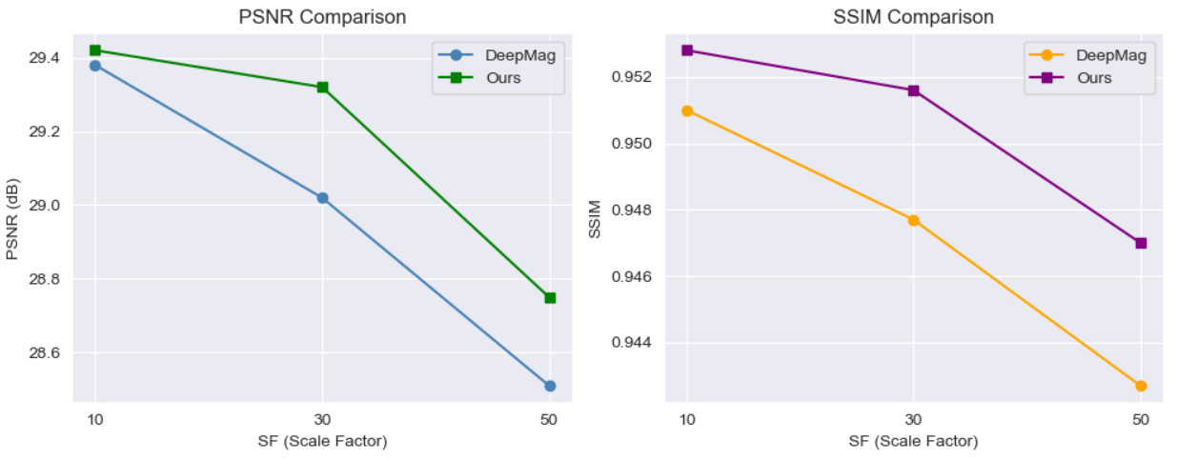
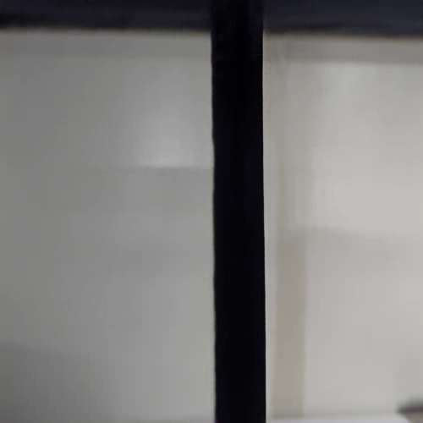
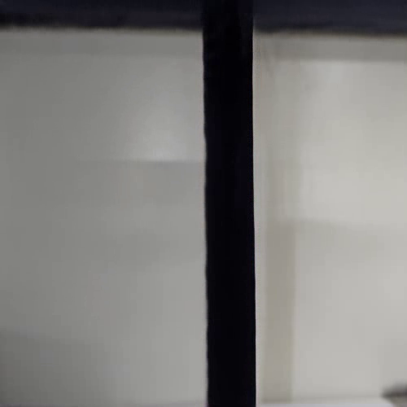
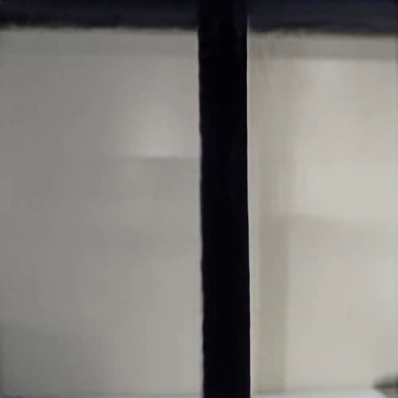
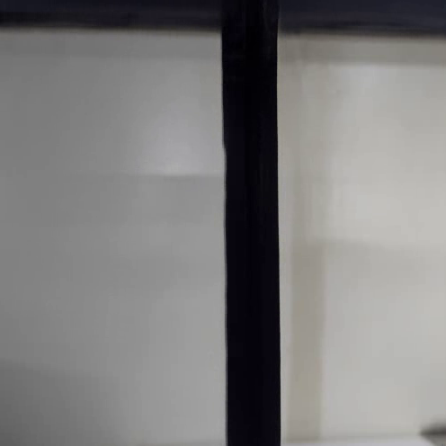
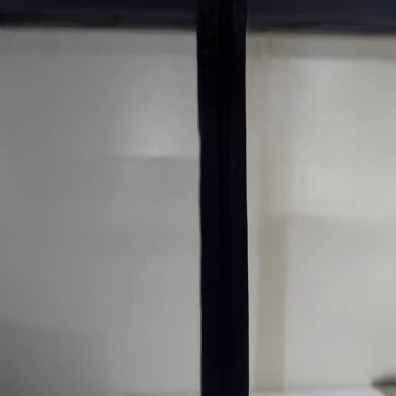
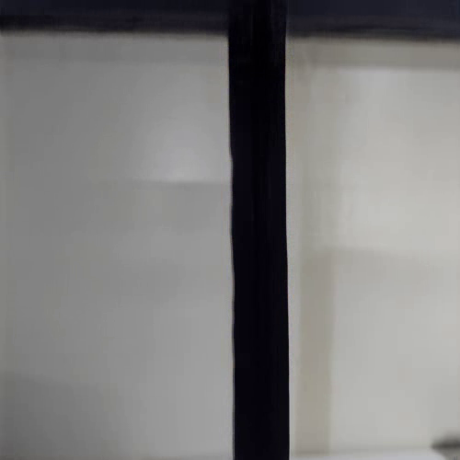
Evaluation
Ground Truth
Deepmag (SF=10)
Deepmag (SF=30)
Deepmag (SF=50)
This image
29.38/0.9510
29.02/0.9477
28.51/0.9427
Set 10 means
24.66/0.9318
24.61/0.9256
23.98/0.9129
Ground Truth
Ours (SF=10)
Ours (SF=30)
Ours (SF=50)
This image
29.42/0.9528
29.32/0.9516
28.75/0.9470
Set 10 means
25.05/0.9362
24.66/0.9329
24.22/0.9252

Slide 8
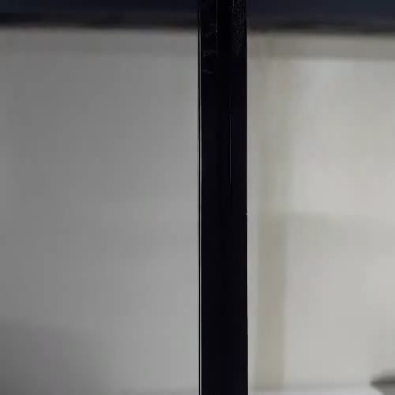
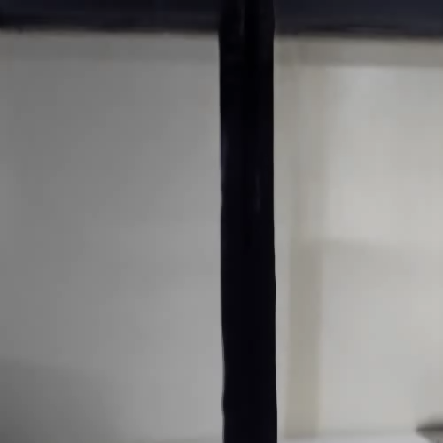
Evaluation

Slide 9
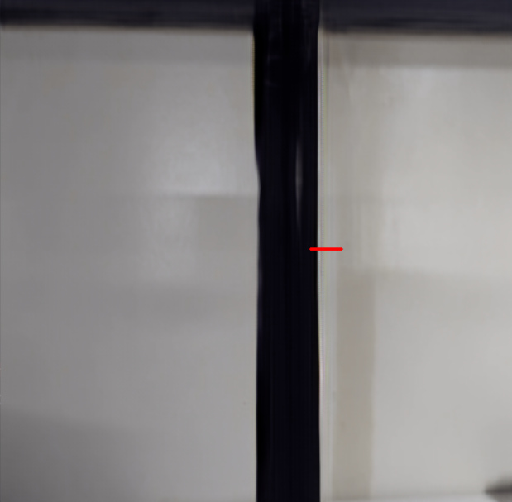

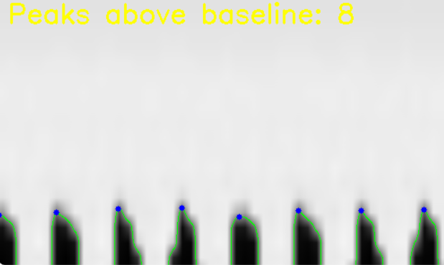
Image processing
Create X-T (Horizontal)
Periodicity of Slice Image → Image-based Vibration Frequency Estimation Possible
Display analysis coordinates as lines for each frame
Find contours in the edge image and consider each as a "vibration waveform".
Magnified Video
X-T slice Video
Magnified Video

Slide 10
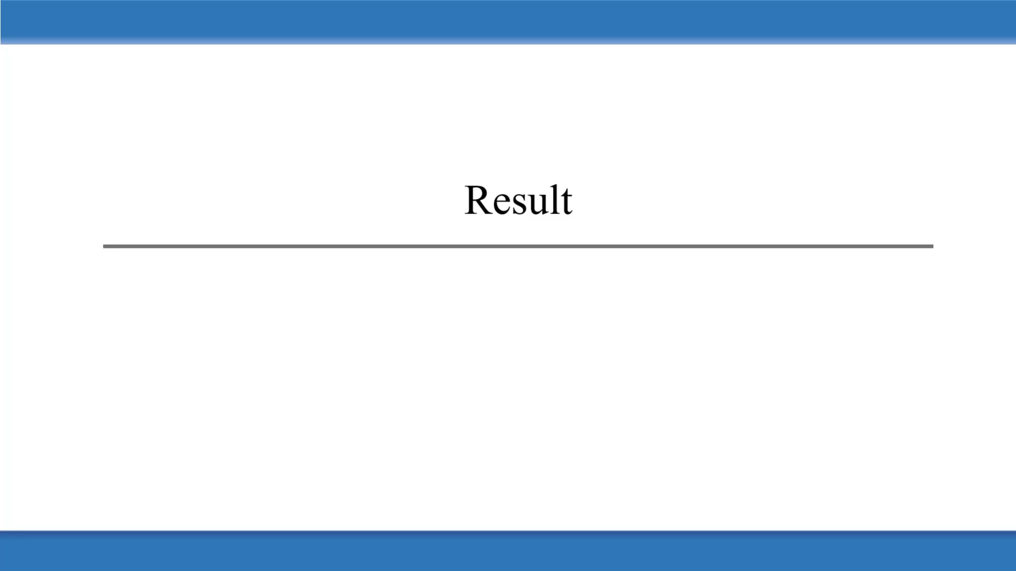
Result

